Slide 1
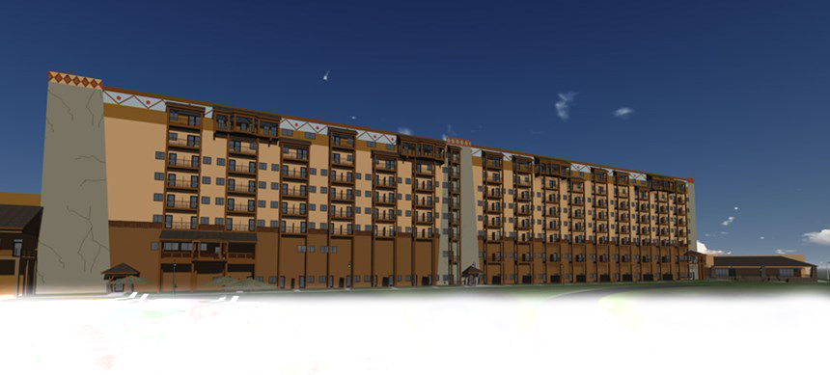
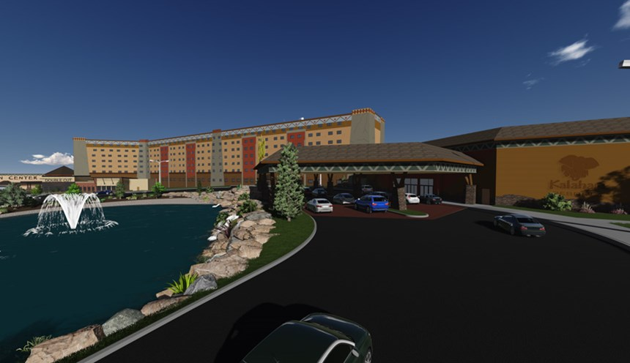
Hakuna Resort
AE Senior Thesis 2015
All Hakuna Resort photos in courtesy of LMN Development LLC
Young Jeon
Structural Option
Advisor: Heather Sustersic

Slide 2
Presentation Outline
I
E
T
S
A
C
Introduction
Existing Structure
Thesis Topics
Structural Depth
Architectural Breadth
Conclusion

Slide 3
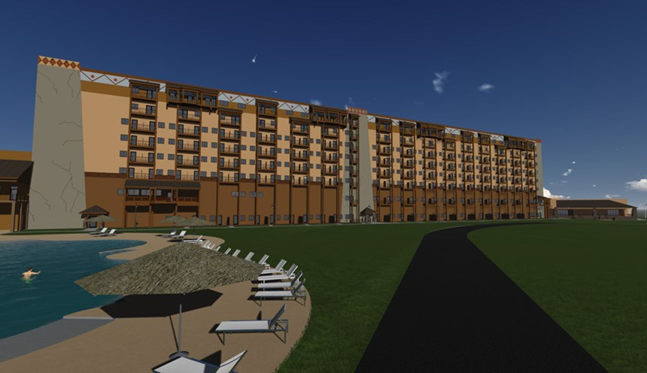
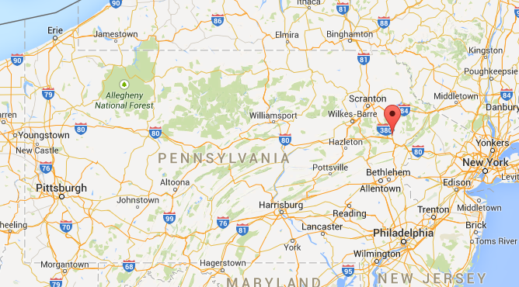
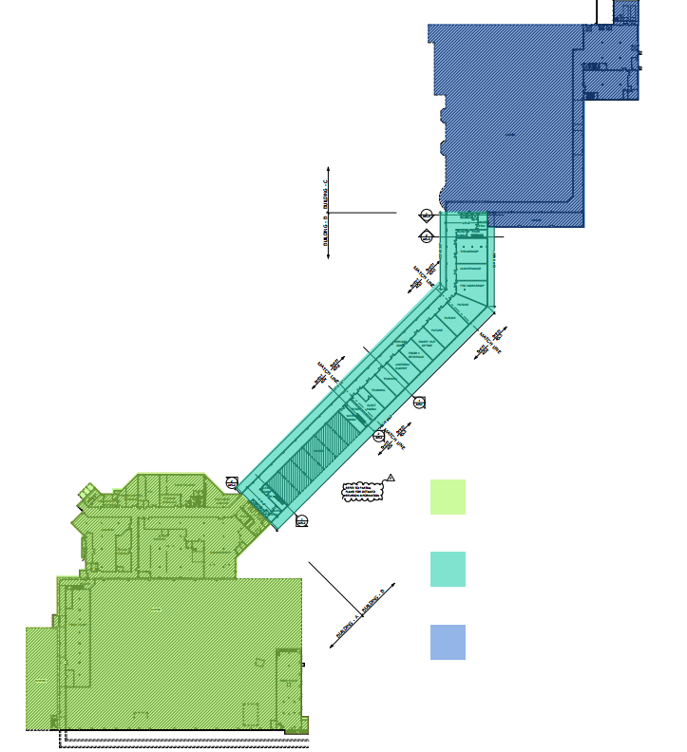

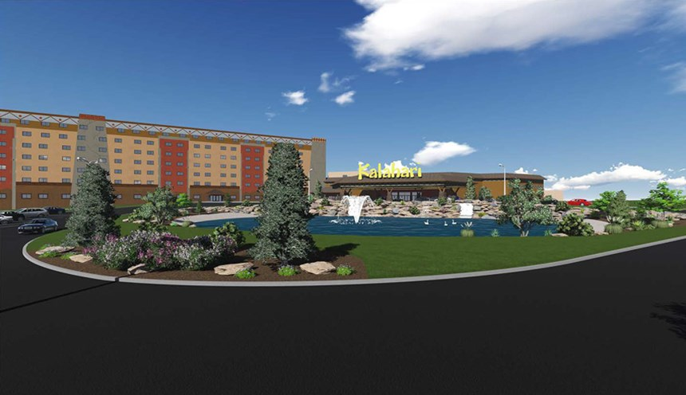
Building Statistics
I
E
T
S
A
C
Hakuna Resort (fictitious)
Swiftwater, PA (fictitious)
Function type: Residential (R-1)
Project total SF: 786,125 SF
Focused SF: 143,107 SF
8 story tall
Date of construction: March 2014 – Summer 2015
Project Total Cost: $230 million
Google Map
courtesy of LMN Development LLC
Waterpark
Hotel
Convention
Owner | LMN Development, LLC
Architect | Architectural Design Consultants
GC | Kraemer Brothers, LLC
MEP/Structural | Harwood Engineering Consultants
Civil | Pennoni Associates, INC.
courtesy of LMN Development LLC

Slide 4
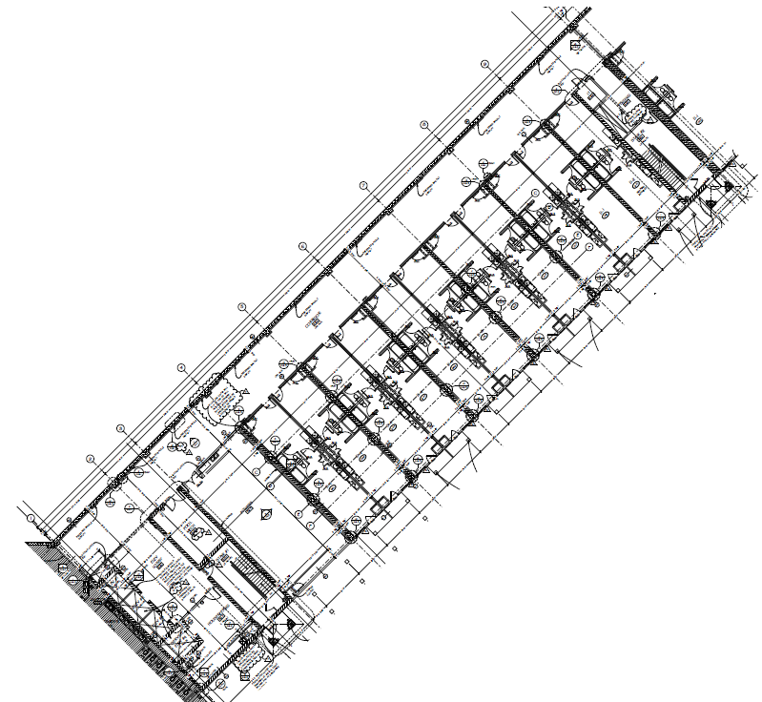
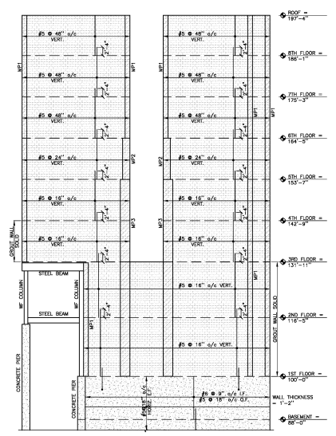
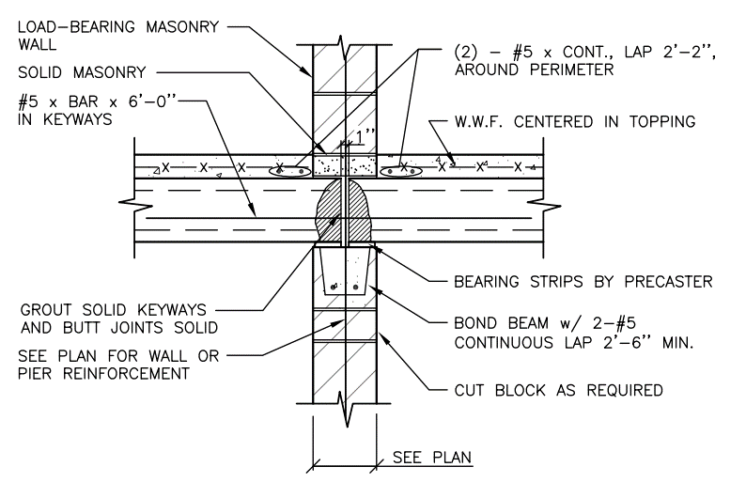
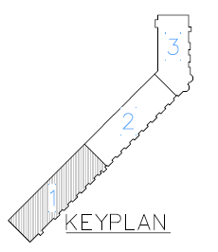
First Floor Plan
Existing Structure
I
E
T
S
A
C
10” & 12” Precast Prestressed Hollow Core Planks with 3” composite topping
Load bearing masonry shear walls
Reinforced concrete shear walls
Steel moment frames

Slide 5
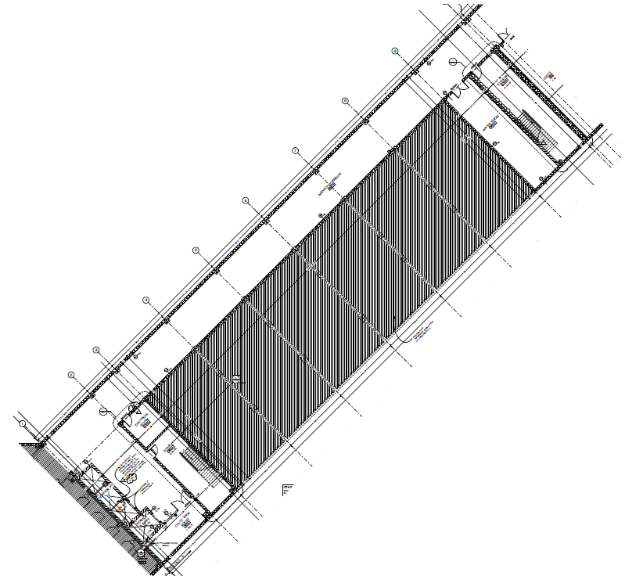
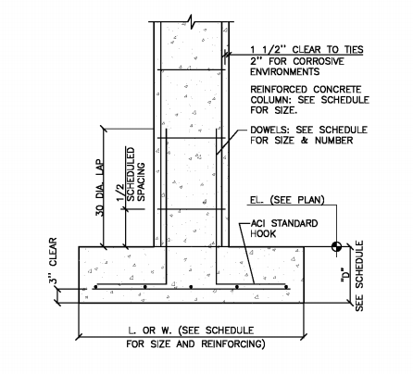
Foundation
4” slab on 1st floor
5” slab on foundation
I
E
T
S
A
C
Portion unexcavated
Strip footing for concrete walls
Spread footing for concrete columns
Footing thickness varies from 2’ to 3’-6”
#9 to #11 reinforcements

Slide 6
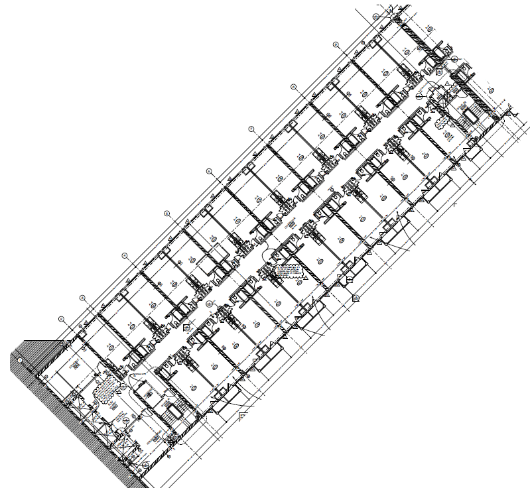
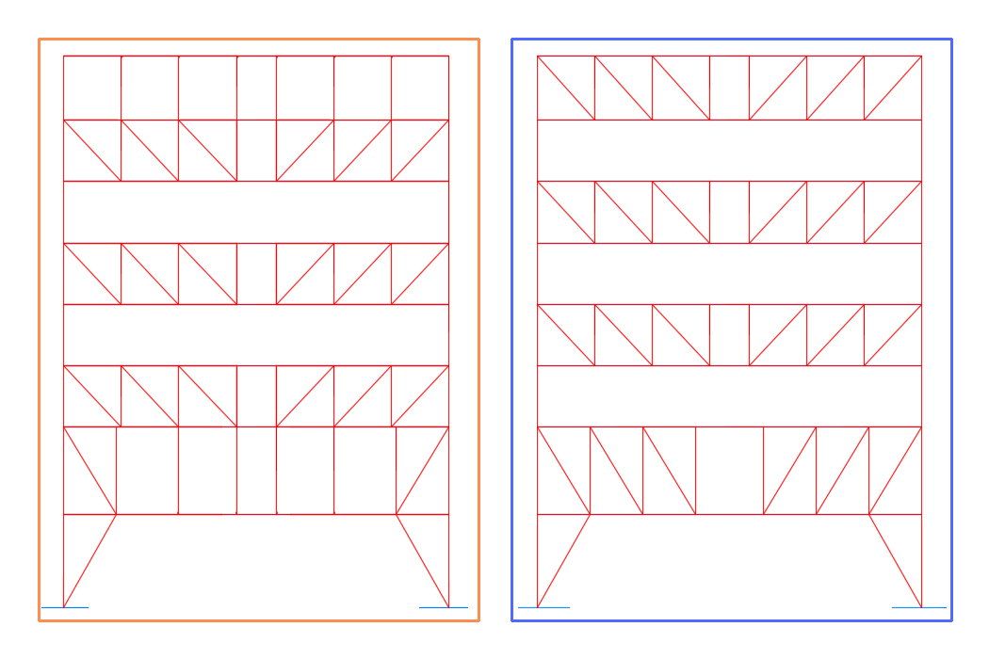
Structural Depth
I
E
T
S
A
C
Purpose:
To compare staggered truss system with existing load bearing masonry shear wall
Advantages:
Repetitive floor layout
Works well with existing hollow core planks
Potential for change in cost and schedule

Slide 7
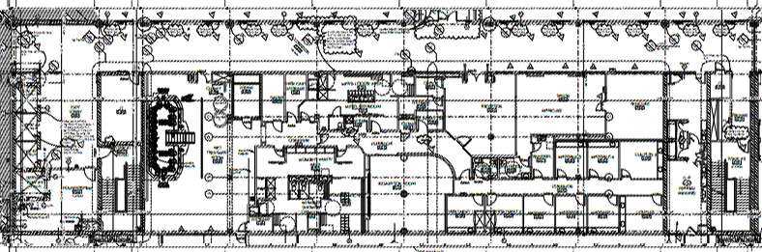
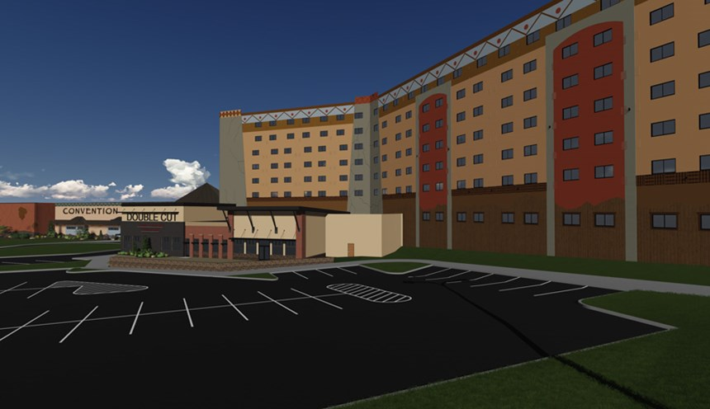
Structural Depth
Architectural Breadth
I
E
T
S
A
C
Purpose:
To compare staggered truss system with existing load bearing masonry shear wall
Advantages:
Repetitive floor layout
Works well with existing hollow core planks
Potential for change in cost and schedule
Purpose:
To redesign first and second floor
To redesign exterior façade
Reasons:
First and second floor requires open spaces for service areas
Existing façade is boring. Add more exciting features
courtesy of LMN Development LLC

Slide 8
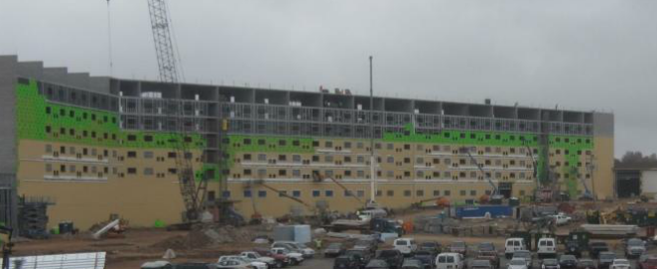
Structural Depth
Architectural Breadth
Construction Breadth
I
E
T
S
A
C
Purpose:
To redesign first and second floor
To redesign exterior façade
Reasons:
First and second floor requires open spaces for service areas
Existing façade is boring. Add more exciting features
  Evaluate the new project construction schedule and cost with the staggered truss system and compare the outcomes
Purpose:
To compare staggered truss system with existing load bearing masonry shear wall
Advantages:
Repetitive floor layout
Works well with existing hollow core planks
Potential for change in cost and schedule
courtesy of LMN Development LLC

Slide 9
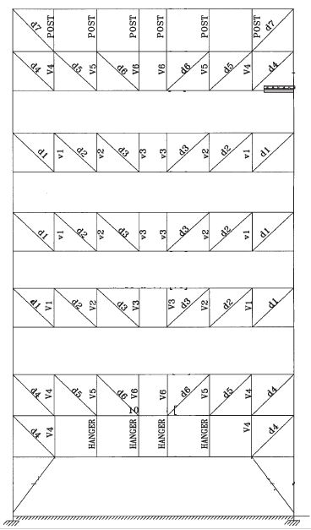
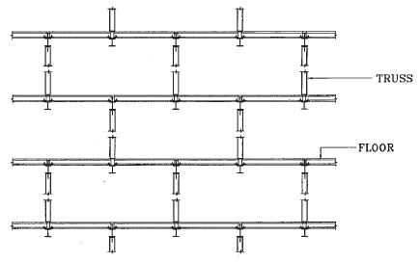
Staggered Truss System
AISC Design Guide 14
I
E
T
S
A
C
    AISC Design Guide 14 – Staggered Truss Framing Systems was used for basic understanding of the system and hand calculation procedure guidance
Central Vierendeel panel for corridor
W-shape chords
W-shape columns
HSS-shape verticals and diagonals
  Representation of staggering of the trusses, allowing more square footage without blocking of walls at each level at every structural gridlines.
Example Truss Frame from AISC Design Guide 14

Slide 10
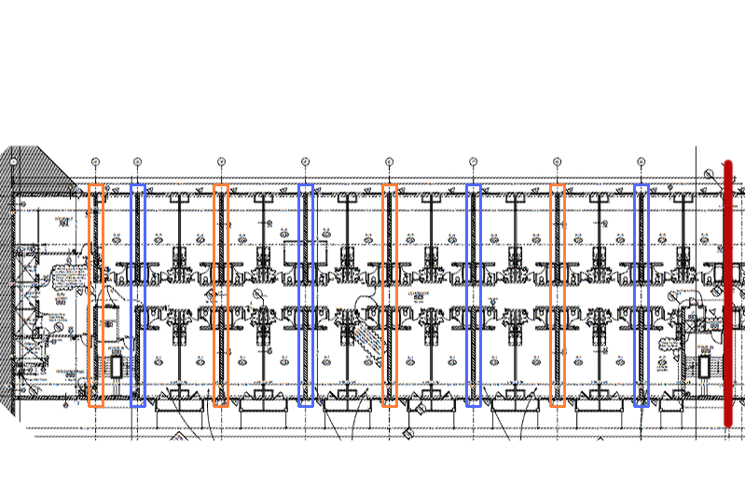
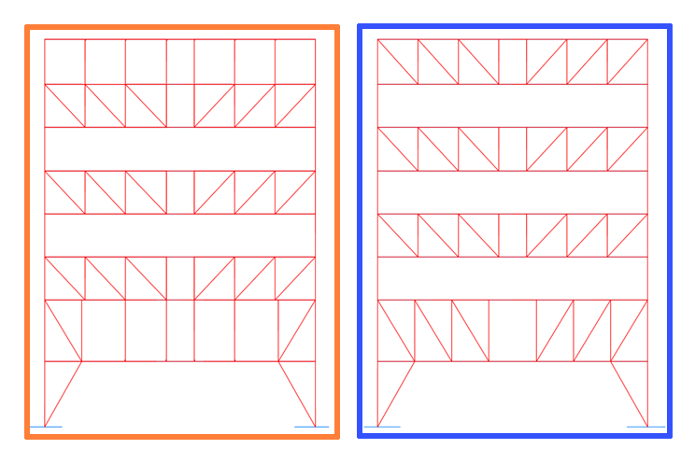
Staggered Truss System
I
E
T
S
A
C
Dead Load
  68 psf – hollow core planks
  37.5 psf – composite topping
  10 psf – super imposed load
Live Load
  40 psf – hotel rooms
  100 psf – corridor
  100 psf – lobby area
Truss 1
Truss 2

Slide 11
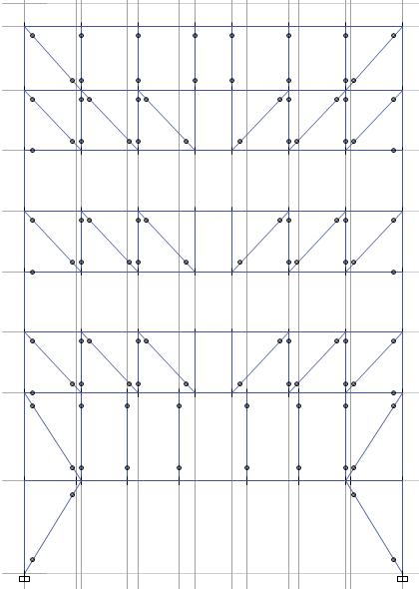
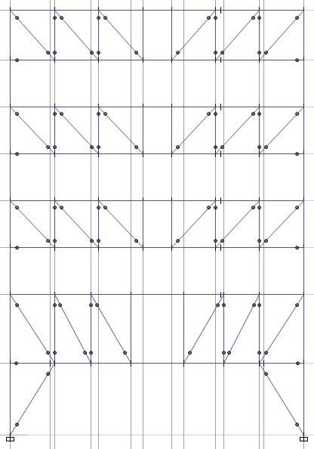
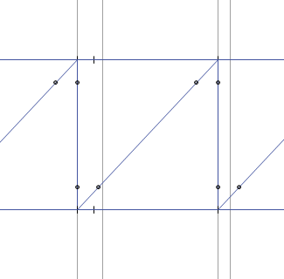
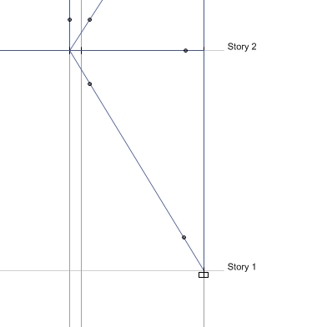
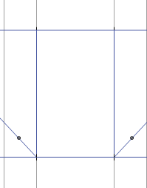
Staggered Truss System
Roof
Roof
I
E
T
S
A
C
8th
Chords continuous and fixed at the ends
Diagonal and vertical members pinned at both ends
Vierendeel panels all fixed
Fixed base
8th
Finish Designs
7th
7th
6th
6th
5th
5th
4th
4th
3rd
3rd
2nd
2nd
1st
1st

Slide 12
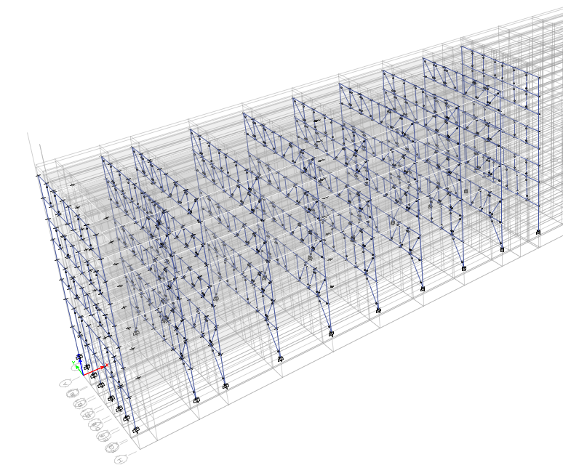
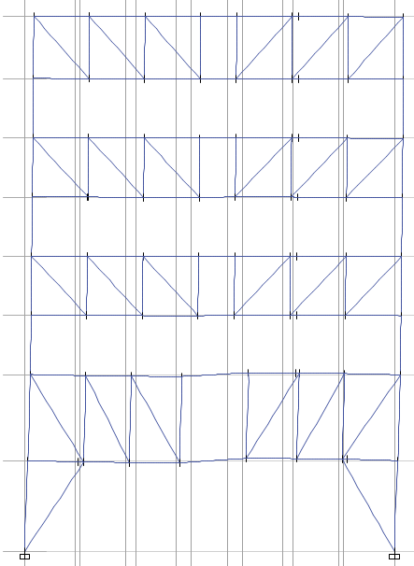
Deflections
I
E
T
S
A
C
Chord deflection
Largest deflection = 0.919” < L/240 = 3.35”
Largest LL deflection = 0.29” < L/360 = 2.23”
Column lateral deflection (wind)
Roof displacement = 0.526” < L/400 = 2.01”

Slide 13
Architectural Breadth
I
E
T
S
A
C
Redesign lower levels floor layout to accommodate the restrictiveness of truss opening.
Redesign the façade to catch people’s attention when they first encounter the resort
courtesy of LMN Development LLC

Slide 14
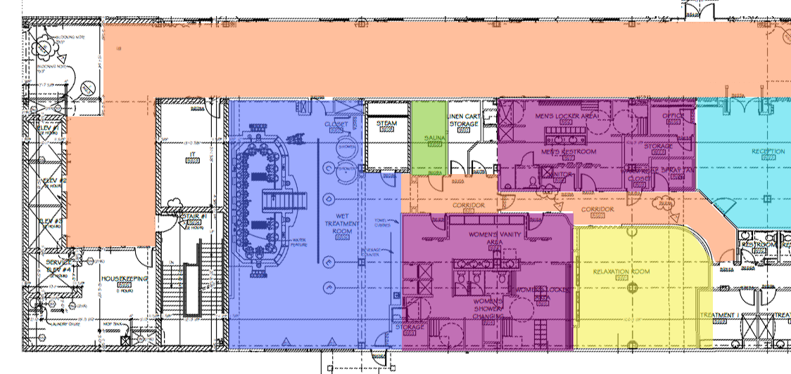
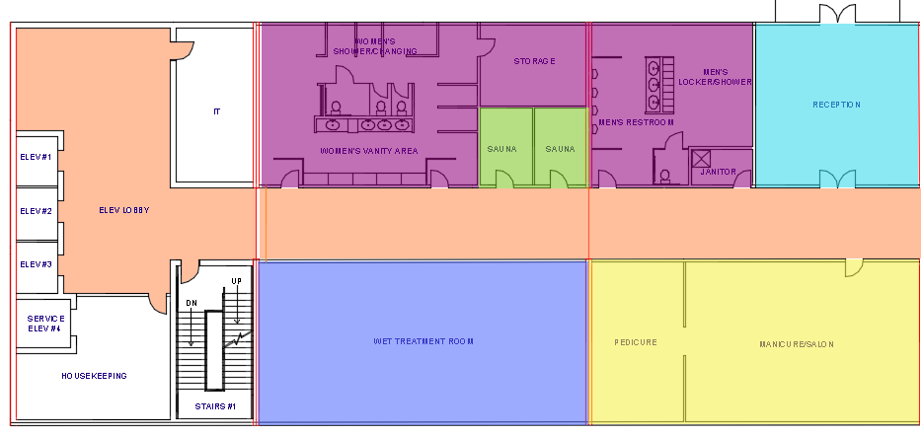
Floorplan Redesign
I
E
T
S
A
C

Slide 15
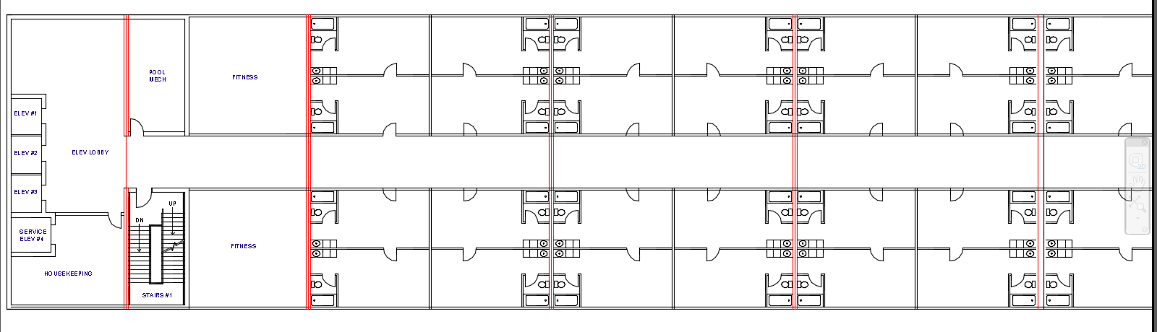
Floorplan Redesign
I
E
T
S
A
C

Slide 16
Façade Redesign
I
E
T
S
A
C
http://7-themes.com/
courtesy of LMN Development LLC

Slide 17
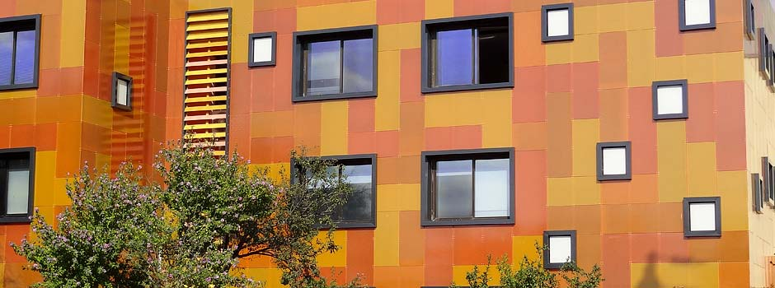
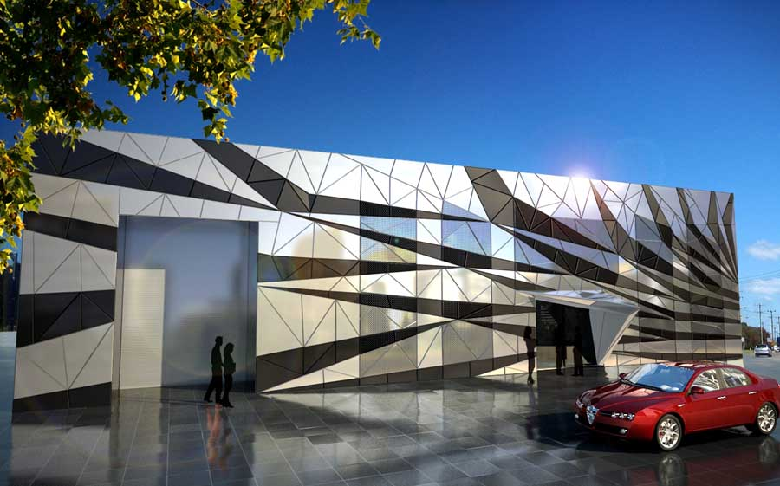
Façade Redesign
I
E
T
S
A
C
http://www.fibrosan.com.tr/
http://7-themes.com/
United Cargo Headquarters Sydney: Condell Park
http://www.e-architect.co.uk/

Slide 18
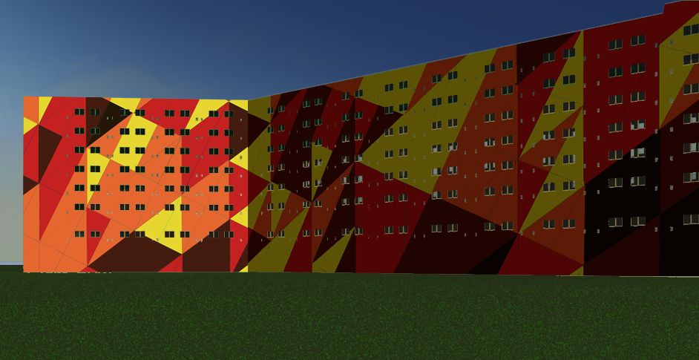
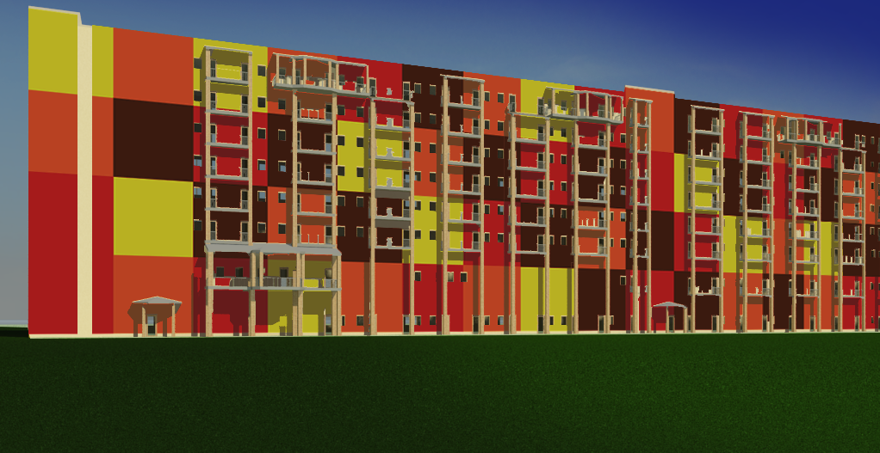
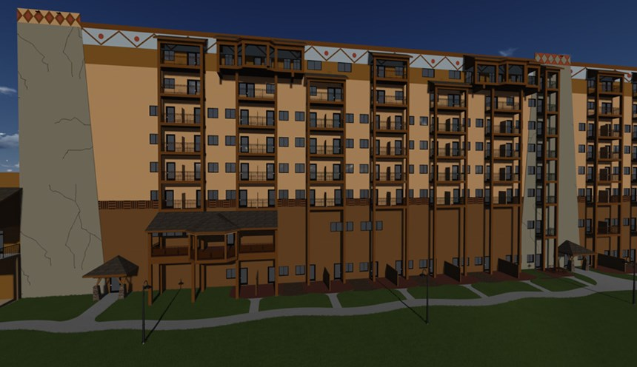
Façade Redesign
I
E
T
S
A
C

Slide 19
Conclusion
I
E
T
S
A
C
Structural
Architectural Breadth
Construction Breadth
Staggered truss system is feasible design
Successfully resist gravity loads and lateral loads in the N-S direction
Great educational experience
Floor layout adjusted according to staggered truss frame layout
May not be the best layout for the service area for privacy
Redesigned hotel façade to be more exciting when encountered
Overall cost increased by $200,000 (0.09% of total project cost)
Schedule reduced by 3 days

Slide 20

Special Thanks to…
LMN Development, LLC
All AE Structural Faculty members
Especially Prof. Sustersic
My family and friends
Heavenly Father and His Son Jesus Christ

Slide 21
Thank you!
Questions?

Slide 23
